Slide 1
NW Agency
Economic and Monetary Policy Update – October 2023
InvestSefton, Bootle CC
Ken Clark, Deputy Agent, North West Agency
Thursday 19th October 2023

Slide 2

Plan for the session
Headlines
Inflation Outlook
Demand Outlook
Financial Policy Summary
What Are Firms Telling Us?
MPC Perspective and Policy Decision
Q&A

Slide 3
Headlines

Slide 4
Main points
Bank Rate rose to 5.25% at the MPC’s August meeting but was held there in September

Slide 5
Main points
Bank Rate rose to 5.25% at the MPC’s August meeting but was held there in September
Inflation will fall back further over the rest of this year
  Recent data has shown inflationary pressures softening

Slide 6
Main points
Bank Rate rose to 5.25% at the MPC’s August meeting but was held there in September
Inflation will fall back further over the rest of this year
  Recent data has shown inflationary pressures softening
Looking ahead, MPC still cautious about inflation being “persistent”. Is looking at labour market tightness, services prices and wage growth to assess this
MPC’s main forecast has inflation falling to the 2% target by 2025Q2, and a little below that further out
Taking account of the risks of persistence, inflation likely to average close to target in the last year of the forecast

Slide 7
Main points
Bank Rate rose to 5.25% at the MPC’s August meeting but was held there in September
Inflation will fall back further over the rest of this year
  Recent data has shown inflationary pressures softening
Looking ahead, MPC still cautious about inflation being “persistent”. Is looking at labour market tightness, services prices and wage growth to assess this
MPC’s main forecast has inflation falling to the 2% target by 2025Q2, and a little below that further out
Taking account of the risks of persistence, inflation likely to average close to target in the last year of the forecast
Weak outlook for GDP – demand has been resilient but the impact of tighter monetary policy will build from here

Slide 8
Inflation developments and outlook

Slide 9
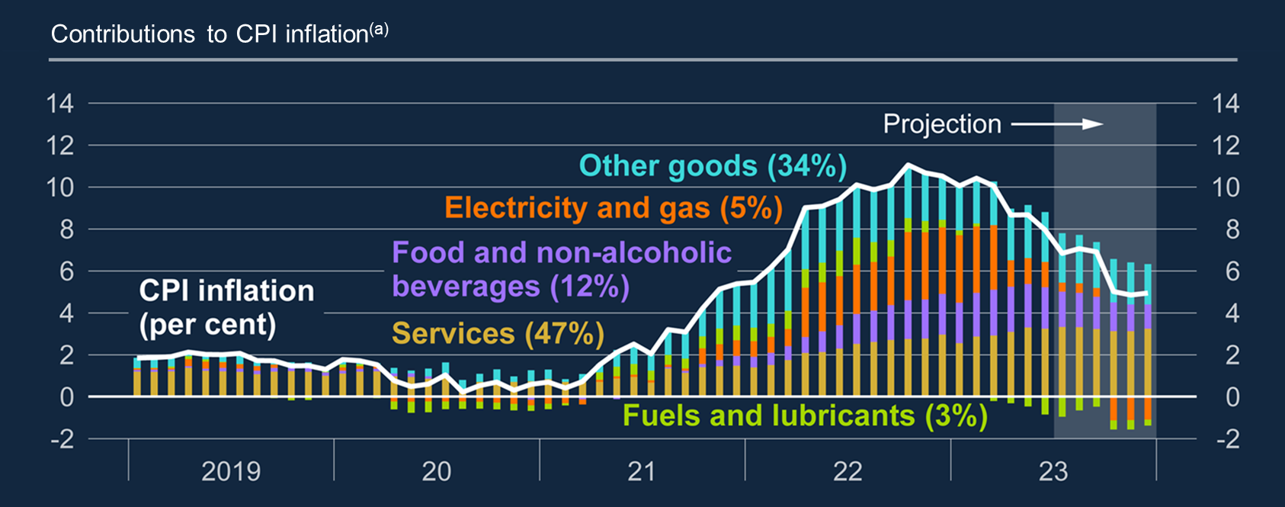
Chart 2.18: Consumer price inflation has fallen since last year’s peak and is projected to fall further as energy prices moderate
Annual energy price inflation will turn negative from October, pulling CPI inflation down to around 5% in Q4

Slide 10
Inflation surprised to the downside in August
Percentage changes on a year ago | Outturn |  | Forecasts |  |  | News
 | August | July | STIF | Market Median | Aug MPR | STIF | Market Median | Aug MPR
CPI | 6.7 | 6.8 | 7.1 | 7.1 | 7.1 | -0.4 | -0.4 | -0.4
Core CPI | 6.2 | 6.9 | 6.8 | 6.8 | 6.8 | -0.6 | -0.6 | -0.6
Core goods | 5.2 | 5.9 | 5.7 | - | 6.1 | -0.5 | - | -0.9
Services | 6.8 | 7.4 | 7.4 | - | 7.2 | -0.6 | - | -0.3
Food and non-alcoholic beverages | 13.6 | 14.8 | 13.5 | - | 14.1 | 0.1 | - | -0.6
PPI Output | -0.4 | -0.7 | - | - | - | - | - | -
PPI Input | -2.3 | -3.2 | - | - | - | - | - | -
CPIH | 6.3 | 6.4 | - | - | - | - | - | -
RPI | 9.1 | 9 | - | - | - | - | - | -

Slide 11
And a little to the upside in September
Percentage changes on a year ago | Outturn |  | Forecasts |  |  | News
 | September | August | STIF | Market Median | Aug MPR | STIF | Market Median | Aug MPR
CPI | 6.7 | 6.7 | 6.6 | 6.5 | 6.9 | 0.08 | 0.2 | -0.25
Core CPI | 6.1 | 6.2 | 6.0 | 6.0 | 6.5 | 0.03 | 0.1 | -0.45
Core goods | 4.7 | 5.2 | 4.8 | - | 5.8 | -0.06 | - | -1.03
Services | 6.9 | 6.8 | 6.8 | - | 7.0 | 0.09 | - | -0.09
Food and non-alcoholic beverages | 12.1 | 13.6 | 12.1 | - | 13.1 | -0.01 | - | -0.94
PPI Output | -0.1 | -0.5 | - | - | - | - | - | -
PPI Input | -2.6 | -2.0 | - | - | - | - | - | -
CPIH | 6.3 | 6.3 | - | - | - | - | - | -
RPI | 8.9 | 9.1 | - | - | - | - | - | -

Slide 12
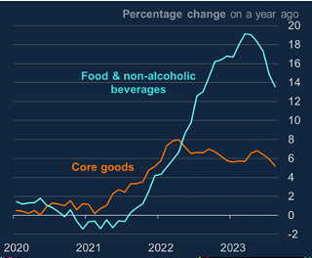
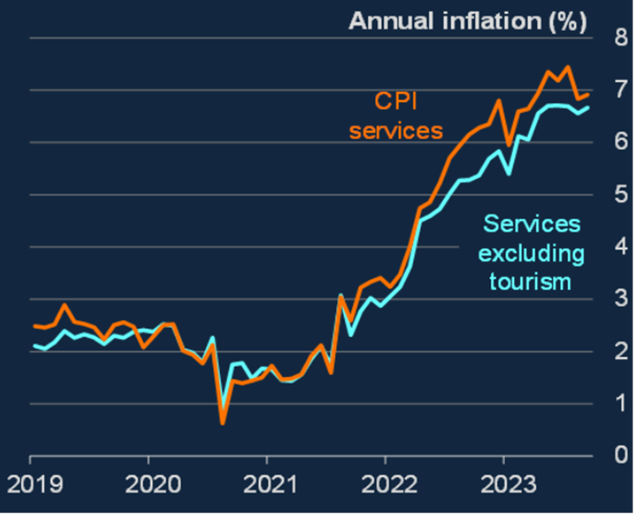
Food price inflation and services have been high but are now easing

Slide 13
Firms’ inflation expectations are falling
Source: September 2023 Decision Makers’ Panel

Slide 14
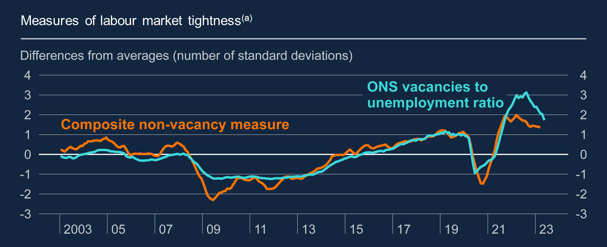
Chart 2.15: The labour market remains tight, although has loosened since mid-2022
MPC has paid particular attention to the vacancy-to-unemployment ratio as a measure of tightness. Was historically high at the beginning of the year.
Still well above its longer-run average but likely to be much closer by the end of the year if current trends continue

Slide 15
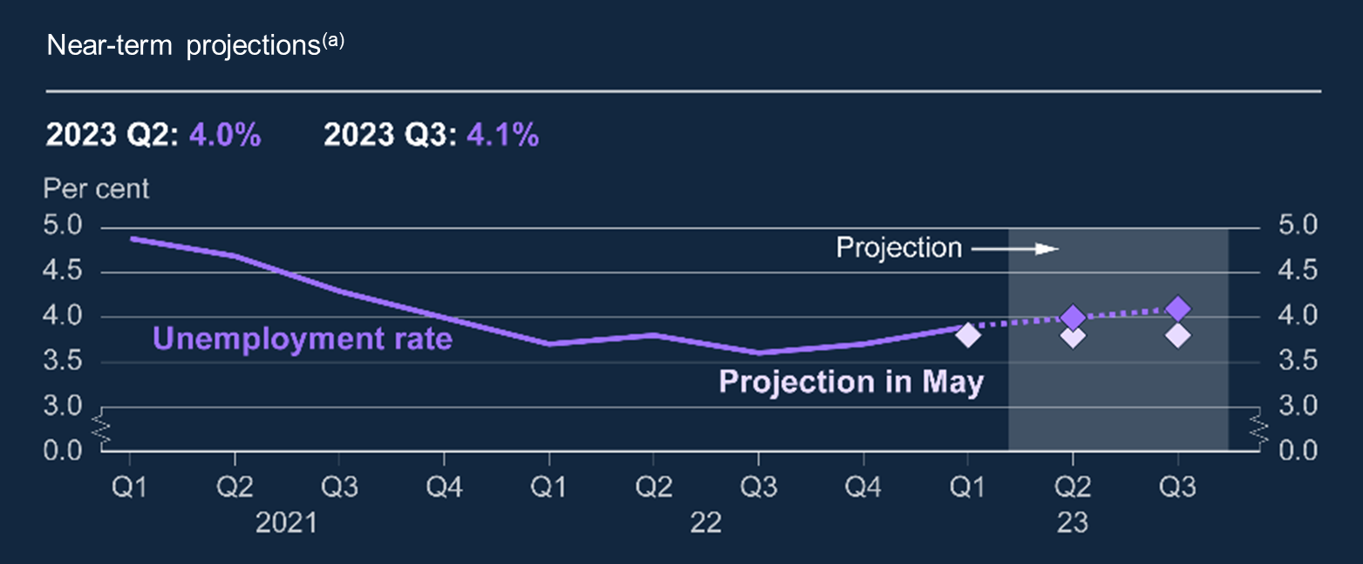
Chart 2.1b: Unemployment rate is expected to rise slightly
Despite employment growth continuing, the unemployment rate has picked up to 4% and is probably on an upward trajectory from here
The labour market is still tight, but there are now signs of loosening

Slide 16
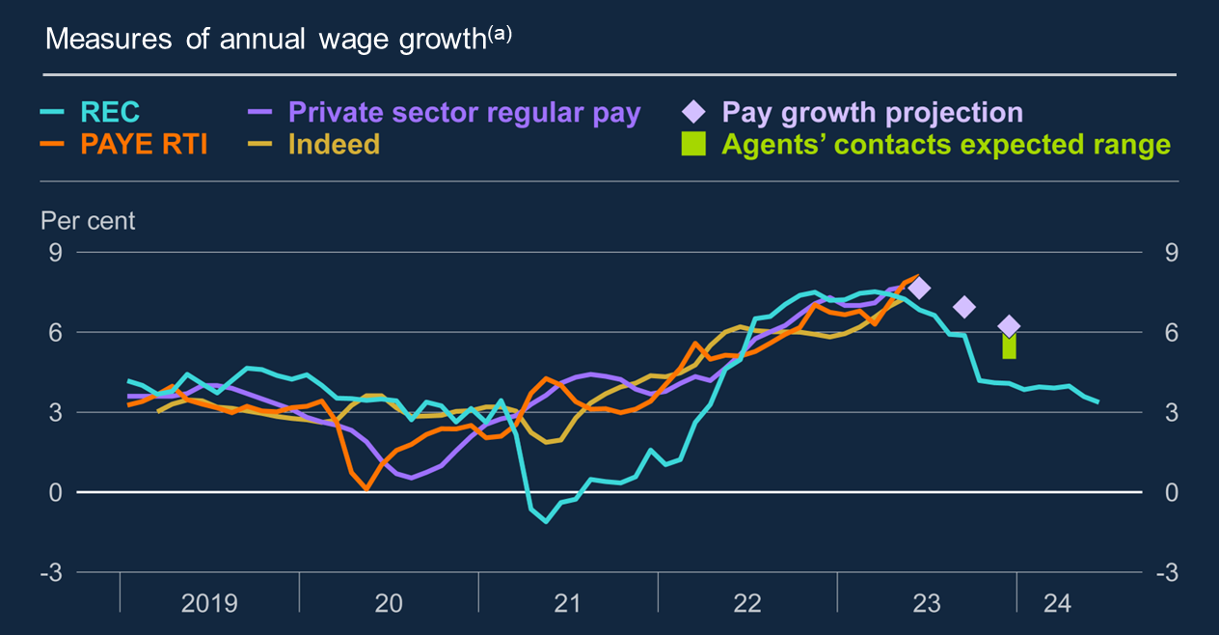
Chart 2.17: Pay growth continues to rise, but forward-looking indicators suggests growth will slow this year
Agents’ contacts continue to expect some moderation in pay growth in the second half of the year. The REC survey has pointed to easing for some time.
But pay growth in private sector has strengthened further, to 7.9% in May and 8.2% in June, falling to 8.1% in July.

Slide 17
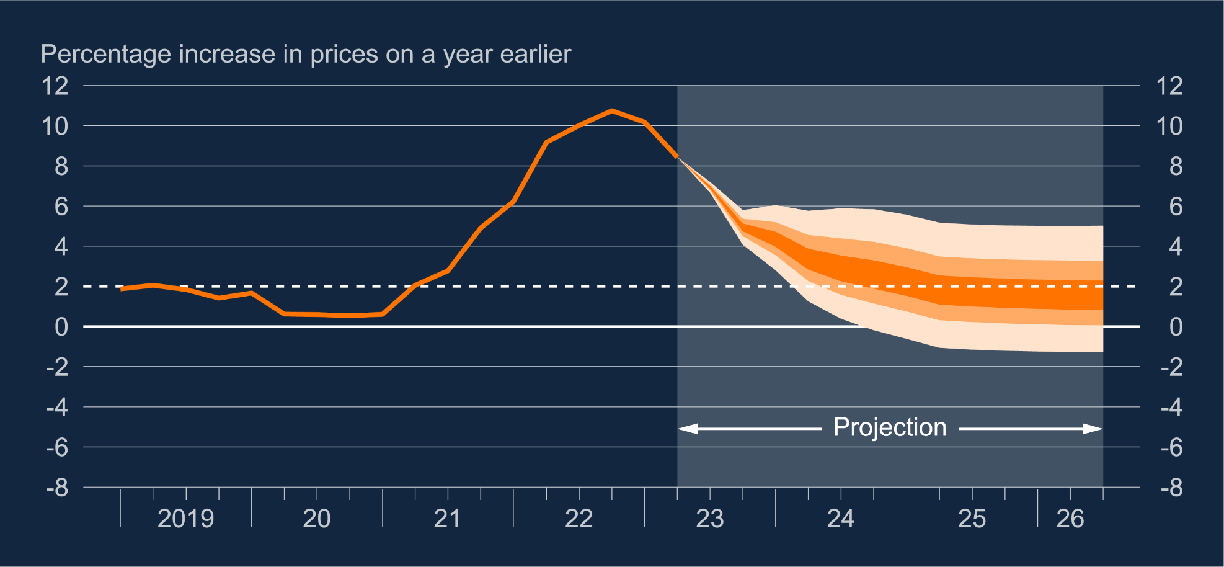
Chart 1.3: CPI inflation projection based on market interest rate expectations, other policy measures as announced
Modal CPI inflation projection reaches 2% in 2025Q2, is 1.7% at year 2 and 1.5% at year 3
Taking account of the risks of persistence, mean CPI inflation likely to average close to target in the last year of the forecast

Slide 18
Demand outlook and the impact of monetary policy

Slide 19
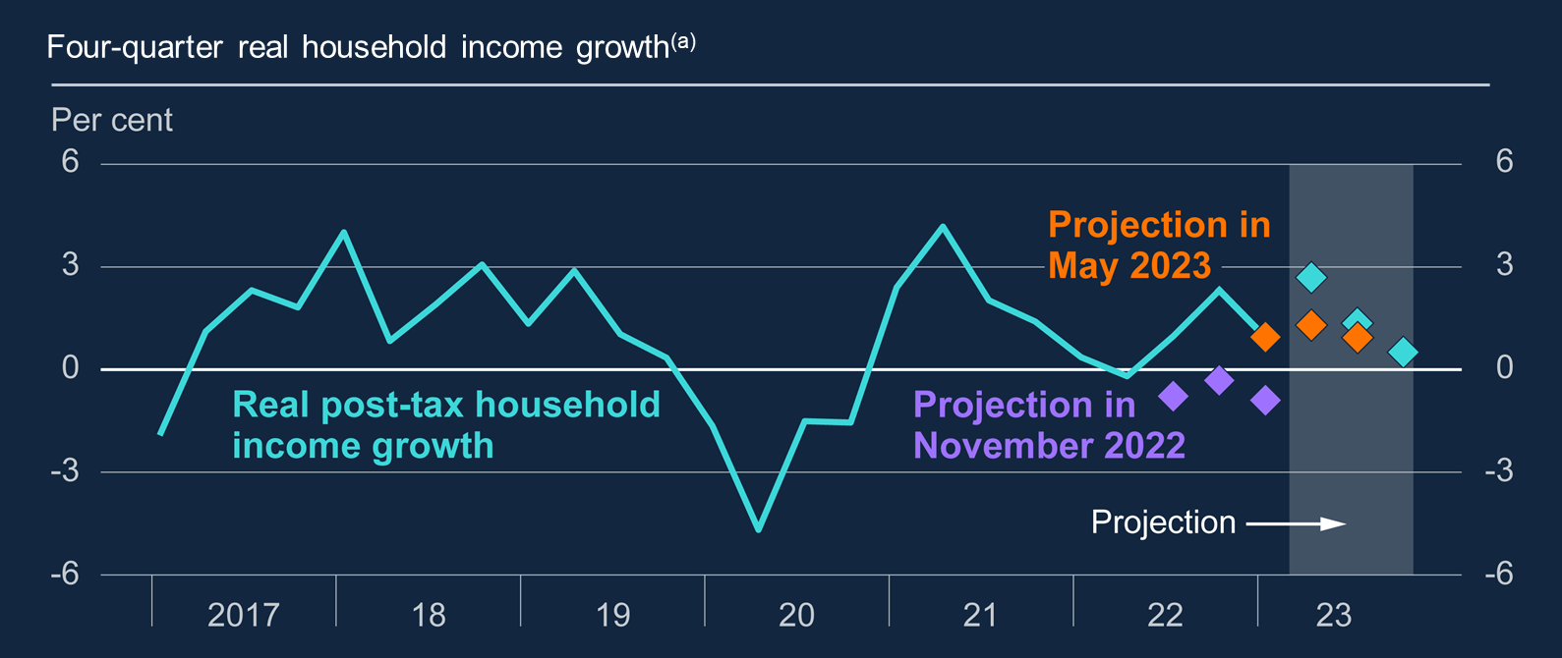
Chart 2.14: Real incomes are projected to rise modestly in 2023
Fiscal support and falling energy prices mean household real income growth has been materially stronger than expected.
This has supported household spending and MPC expect some of this resilience to continue.

Slide 20
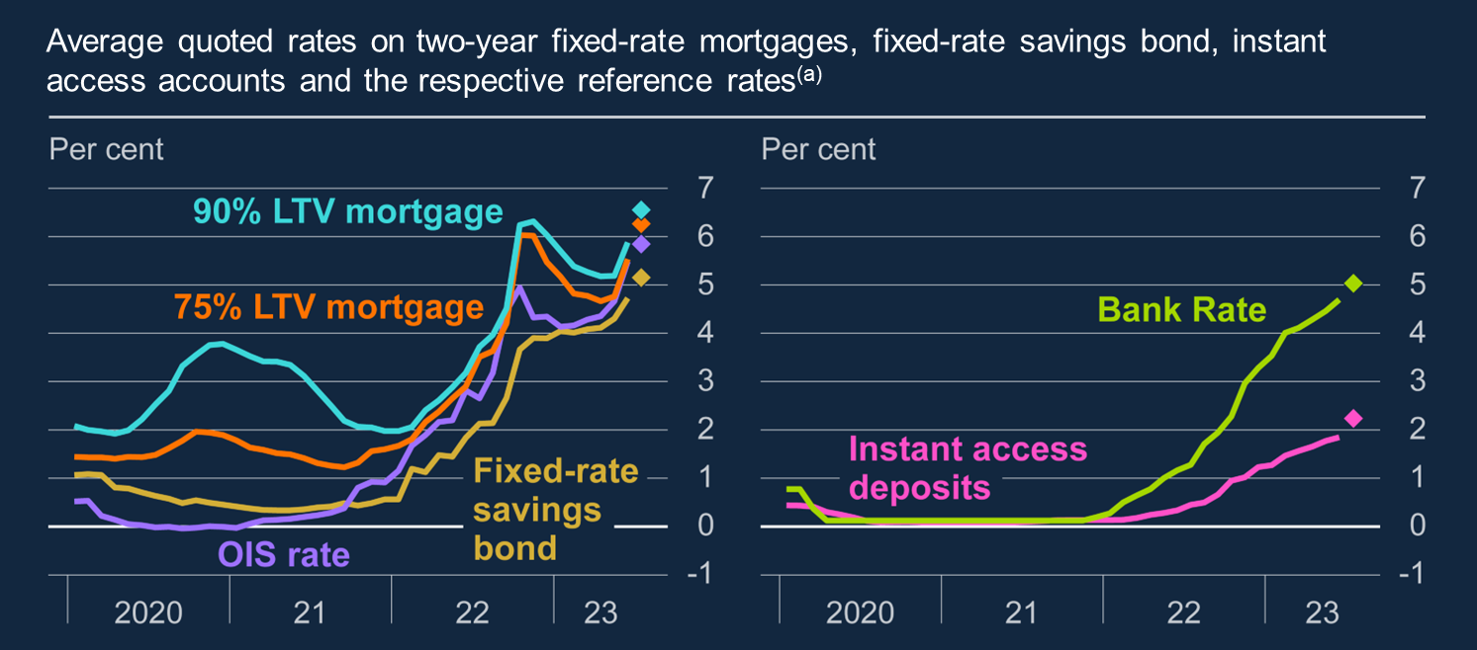
Chart 2.5: Interest rates on fixed-rate mortgages and fixed-rate bonds have risen in line with reference rates; instant access by less
If anything, higher market interest rates have fed through to mortgage rates more rapidly than expected
Mortgagors will refix only gradually, so cashflow effects will take time

Slide 21
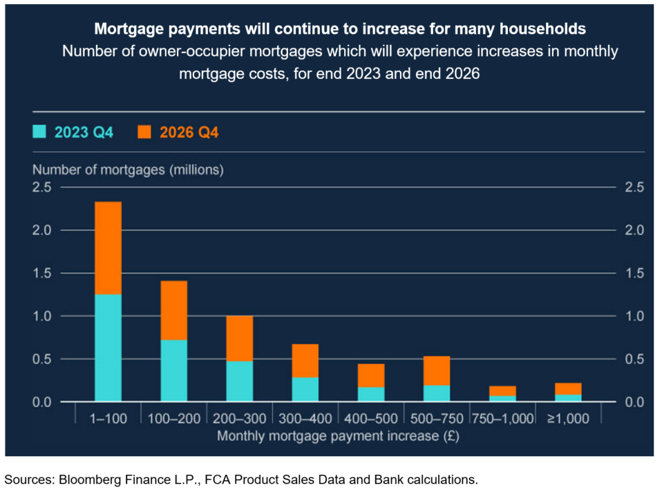
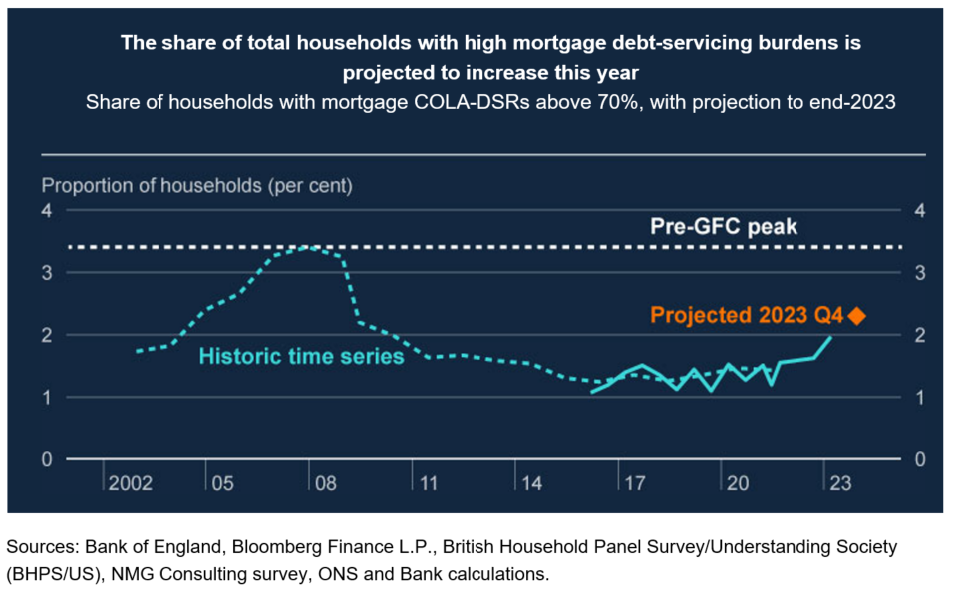
UK household and business are under pressure from higher borrowing costs
These trends imply that more households with mortgages will be more vulnerable to repayment difficulties, including in the event of further shocks e.g. to the cost-of-living

Slide 22
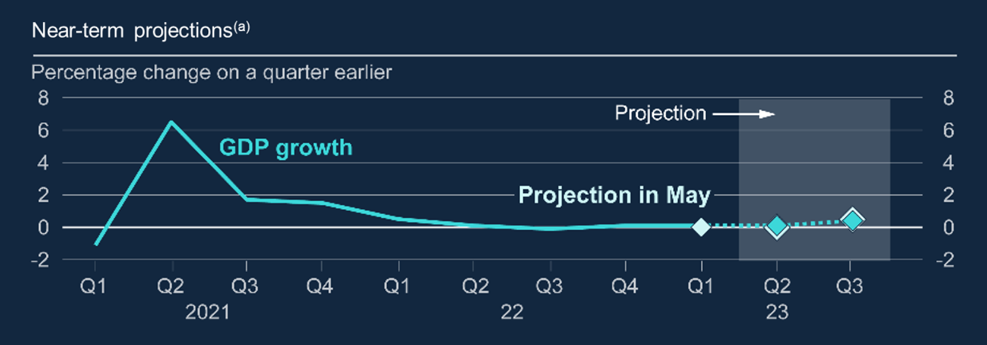
Chart 2.1a: GDP growth is expected to remain positive but low
But still a weak GDP picture in absolute terms – maybe only ¼% growth per quarter, once impact of strikes and extra bank holidays removed

Slide 23
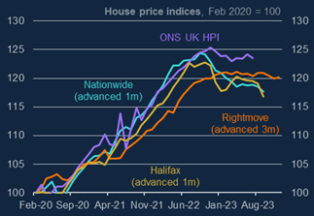
House prices have been falling and indicators suggest that this will continue in the near term
Housing market showing clear signs of slowing
House price measures are flat to falling (and down considerably in real terms)

Slide 24
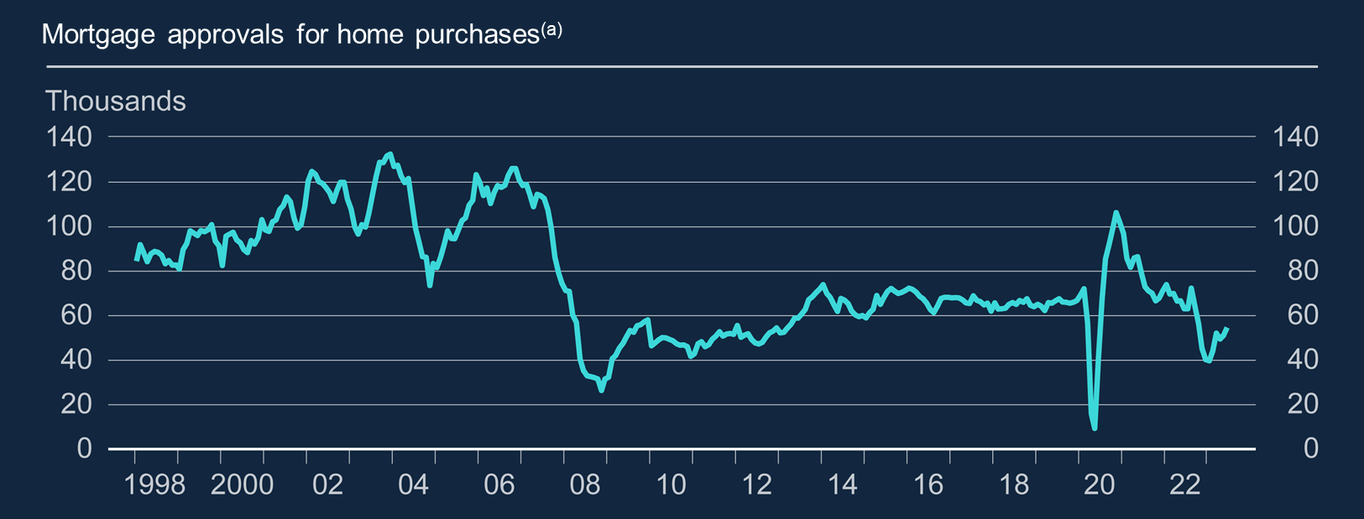
Chart 2.8: The number of housing transactions has fallen
Housing market transactions have picked up from its trough, but remains weak compared with history…

Slide 25
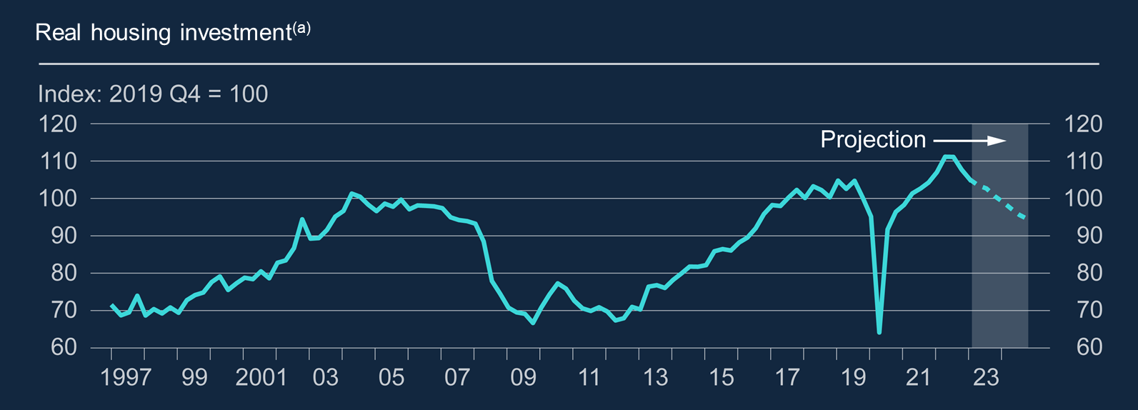
Chart 2.9: Housing investment is falling, which is projected to continue
…as a result, housing investment now declining and likely to continue to do so

Slide 26
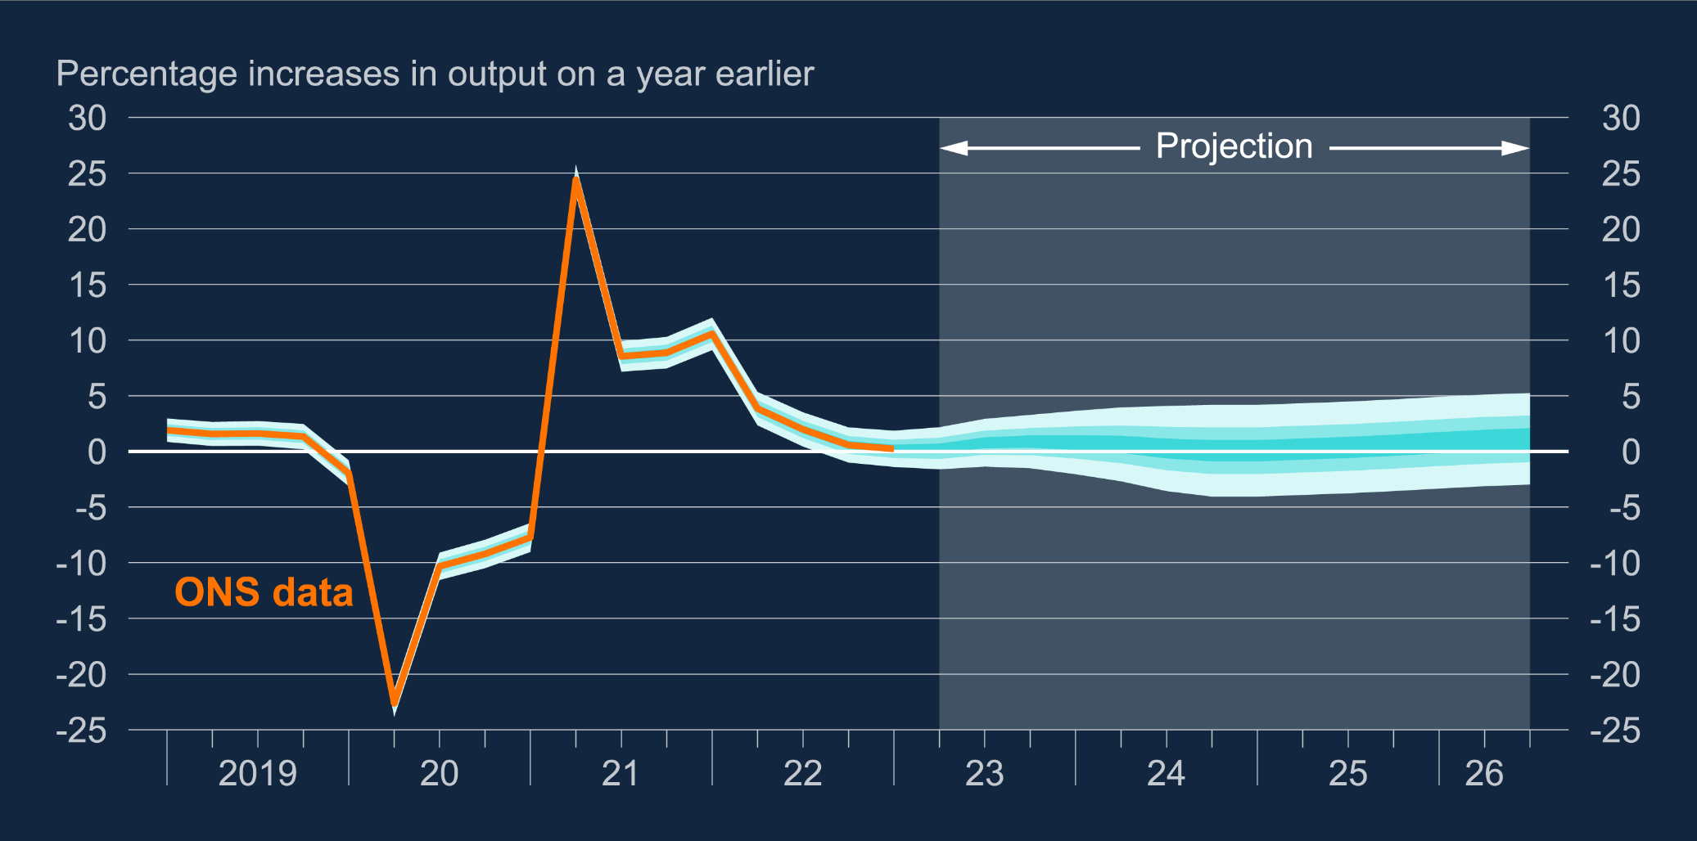
Chart 1.1: GDP growth projection based on market interest rate expectations, other policy measures as announced
Weak outlook for GDP over the forecast period of around ½% per year…
…leading to slack opening up in the economy from the beginning of next year

Slide 27
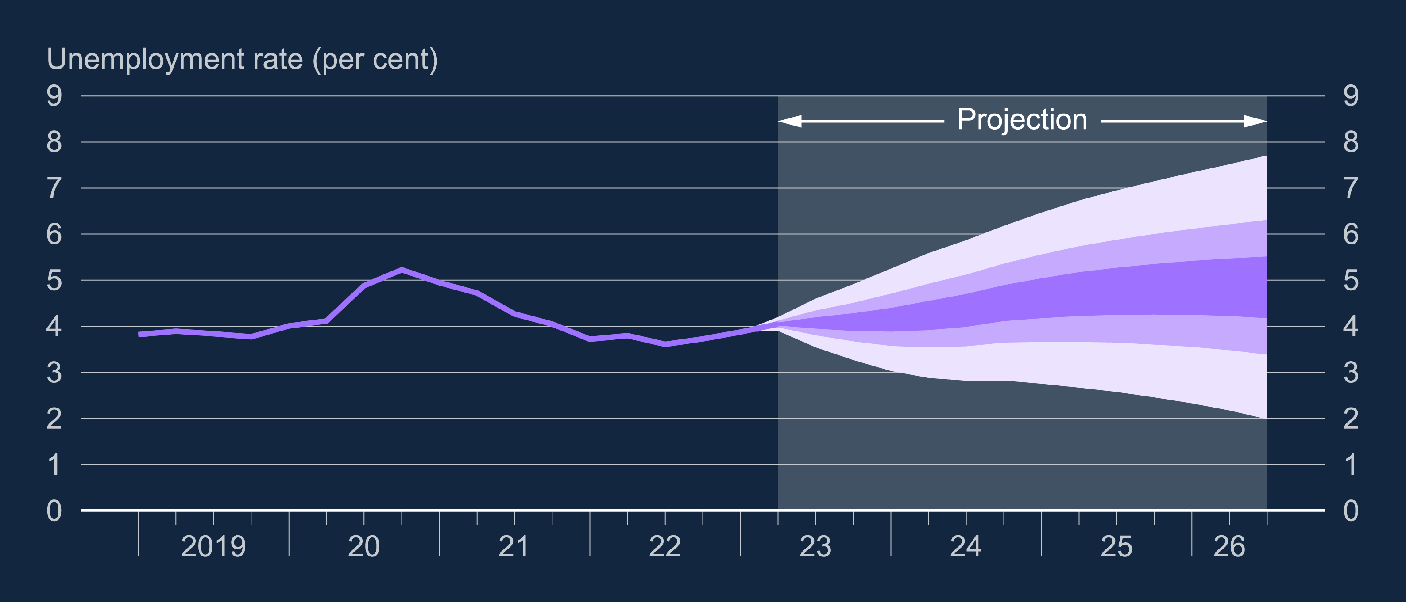
Chart 1.2: Unemployment rate projection based on market interest rate expectations
MPC project loosening to continue over the forecast as spare capacity
Unemployment rate likely to rise gradually to 4.8%

Slide 28
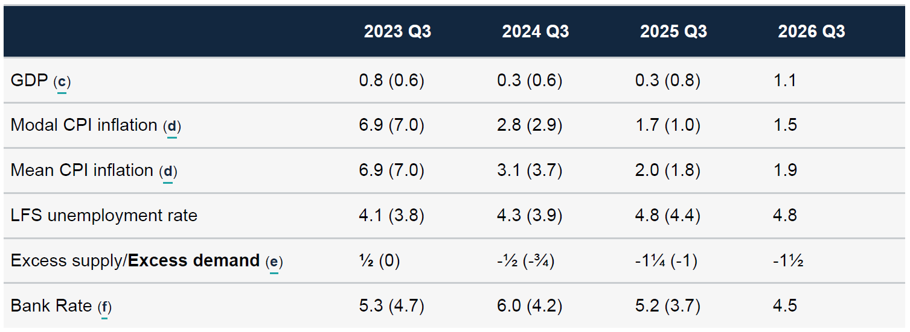
Table 1.A: Forecast summary
Modal CPI inflation projection reaches 2% in 2025Q2, is 1.7% at year 2 and 1.5% at year 3
Alternative scenario with constant Bank Rate provides a very similar forecast

Slide 29
Financial Policy Summary

Slide 30


Financial Policy Summary October 2023
More persistent inflation, higher interest rates and geopolitical tensions make the current risk outlook challenging. We may see stress from higher interest rates in an environment of low growth and falling property prices (e.g. China).
UK household and businesses are facing costs of living pressures and higher borrowing costs. Full costs of rates not yet passed through to households but banks in a strong position to support customers. Smaller businesses struggling the most with higher financing costs.

Slide 31



Financial Policy Summary October 2023
The UK banking system remains strong enough to support households and businesses, even if economic conditions are worse than we expect. UK banks are well capitalised and performed well in recent stress tests. Banks are not excessively withdrawing credit from the market.
Risks linked to non-bank finance remain. We are working globally and domestically to tackle these. Equities, corporate bonds, insurance, pension and other funds are an increasingly important source of finance for UK firms. We need to work better to understand the potential sources of instability.

Slide 32
What are firms telling us?

Slide 33



Some headlines from Agency intelligence
Manufacturing output broadly stable. Export-focused manufacturers reported higher output, especially in the defence, pharmaceutical, and energy sectors. Contacts said the outlook for output was also positive, based on substantial order books.
Retailers seeing consumers more cautious, trading down and/or seeking value. Concerns that Christmas will see subdued demand. Contacts were increasingly pessimistic about the effect of higher mortgage payments and wider cost of living pressures on consumer spending over the coming year
Construction output volumes continued to fall, driven by softer demand from the public sector and in housing. Higher costs and planning constraints also affected output. Hopes that repair and maintenance will compensate.

Slide 34



Some headlines from Agency intelligence
In CRE markets, transaction volumes for investor purchases continued to remain subdued reflecting higher finance costs and uncertainty around valuations. Banks were more cautious about new lending for commercial development or purchase.
Labour markets have loosened in most sectors. Now seeing recruitment easier for higher skill roles. Pockets of tightness remain e.g. engineering or tech skills. Pay settlements falling but concerns remain about NLW.
Credit supply remained tight in all sectors, and lenders were scrutinising affordability more. Credit demand was still weak, with some businesses making early repayments because of concerns about the higher cost of capital. Financial stability: seeing higher insolvencies in construction and hospitality.

Slide 35
MPC perspective and policy

Slide 36
MPC decision: hold Bank Rate at 5.25%
Majority decision (5 members), hold Bank Rate: A “finely balanced” decision. They noted that the labour market was loosening, that while official pay data remained strong, other pay indicators were weaker and recent inflation outturns had surprised to the downside. “Conditions were likely to warrant a restrictive policy stance being maintained until material progress had been made in returning inflation to the 2% target sustainably.”
Minority (4), another 0.25ppts rise: labour market was only loosening slightly and some measures of activity still strong. “overall there was evidence of more persistent inflationary pressures”.

Slide 37
MPC perspective and policy
“The MPC would continue to monitor closely indications of persistent inflationary pressures and resilience in the economy as a whole, including the tightness of labour market conditions and the behaviour of wage growth and services price inflation. Monetary policy would need to be sufficiently restrictive for sufficiently long to return inflation to the 2% target sustainably in the medium term, in line with the Committee’s remit. Further tightening in monetary policy would be required if there were evidence of more persistent inflationary pressures”

Slide 38
Q&A

