Slide 1

PRESENTATION:
Economic Strategy Consultation
SEFTON COUNCIL| JUNE 2022

Slide 2
INTRODUCTION
Nigel Wilcock, Mickledore

Slide 3
ECONOMIC STRATEGY CONSULTATION
Strategy refresh post-Covid impacts
Issues and Opportunities
Questionnaire will be sent to you later this month – Please Complete (5 mins max)
Today a few key thoughts – many of which will not be a surprise

Slide 4
MODERATE PERFORMANCE
At Authority level data, Sefton does not deviate too far from the North West Average in economic measures
Variable | Sefton | NW England | National (GB)
Economically active (Dec 2021) | 77.4% | 76.5% | 78.4%
Percentage households workless (Dec 2020) | 15.8% | 15.5% | 13.6%
Percentage employed as managers or professionals (Dec 2021) | 33.2% | 32.1% | 34.2%
Qualified NVQ4 or above (2021) | 39.1% | 38.5% | 43.5%
Gross weekly pay for residents (2021) | £586.7 | £578 | £613.1
Claimant count (out of work benefits) working age population (2022) | 4.3% | 4.4% | 3.9%

Slide 5
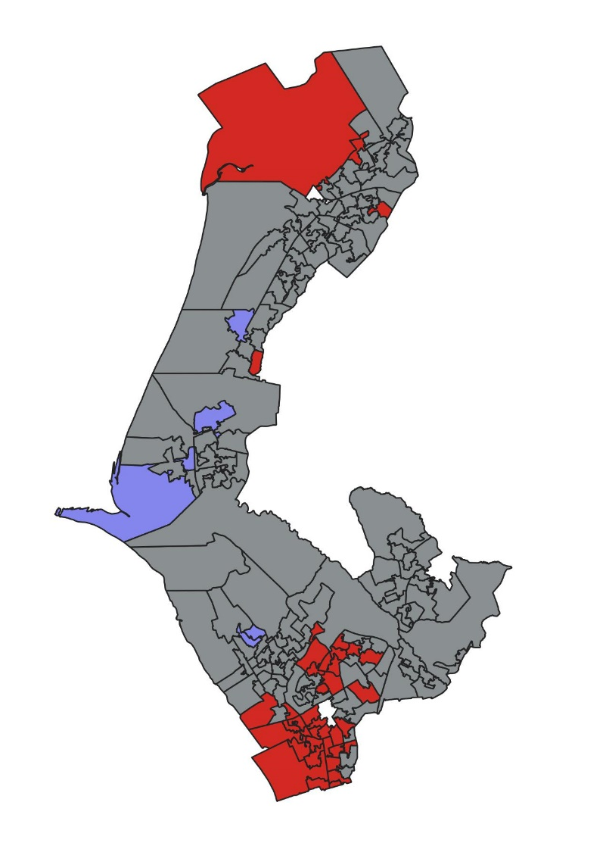
INCOME DISPARITY
But averages have a tendency to smooth over issues – income distribution across the Borough is extremely uneven
All areas have similar population. Size of this area reflects low population density NOT a higher proportion of deprivation
Key
Boundaries show Lower Level Super Output Areas (LSOAs)
Red = most deprived 10% in England
Blue = least deprived 10% in England

Slide 6
DISPARITIES WITHIN SEFTON
The social and economic narrative of Sefton has to reflect a more granular approach to secure the attention of policy makers

Slide 7
IMPORTANCE OF PUBLIC SECTOR
Ward | Percentage of employment public sector
Ford | 61.9
Derby | 60.5
Sudell | 57.1
Kew | 39.9
St Oswald | 38.4
Linacre | 38.3
Manor | 30.6
Sefton Average | 24.6
Ainsdale | 23.6
Birkdale | 23.0
Harington | 22.6
Litherland | 19.1
Meols | 18.4
Park | 17.3
Church | 17.3
England Average | 16.8
Blundellsands | 15.8
Netherton and Orrell | 14.5
Cambridge | 13.8
Victoria | 10.7
Duke's | 10.5
Molyneux | 10.4
Ravenmeols | 7.2
Norwood | 4.7
Only 8 Sefton Wards record public sector employment below the average for England – and in Ford ward (Bootle) 61.9% of employees is provided by the public sector

Slide 8
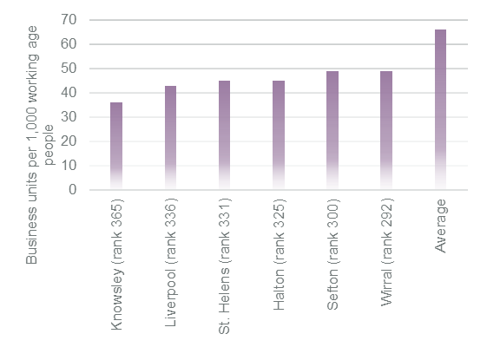
LOWER LEVELS OF BUSINESS ACTIVITY
Business Density (business units / 1,000 working age residents) – rank out of 374 Local Authorities)
Meanwhile business density is low – but this is a City Region wide issue

Slide 9
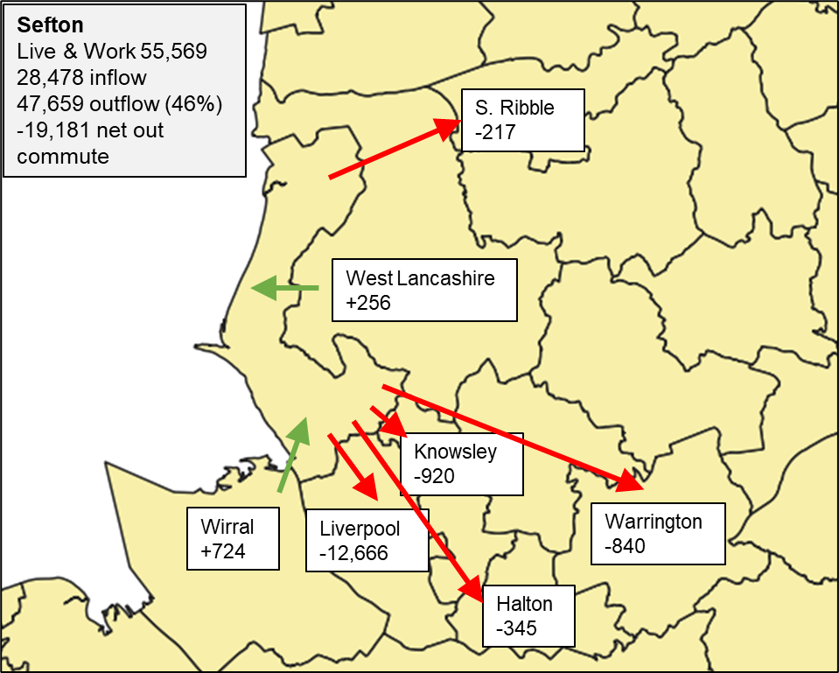
RESIDENTS LEAVE THE BOROUGH TO WORK
Net commuting flows Sefton (>100)
Close to half of working residents undertake their job outside the Borough

Slide 10
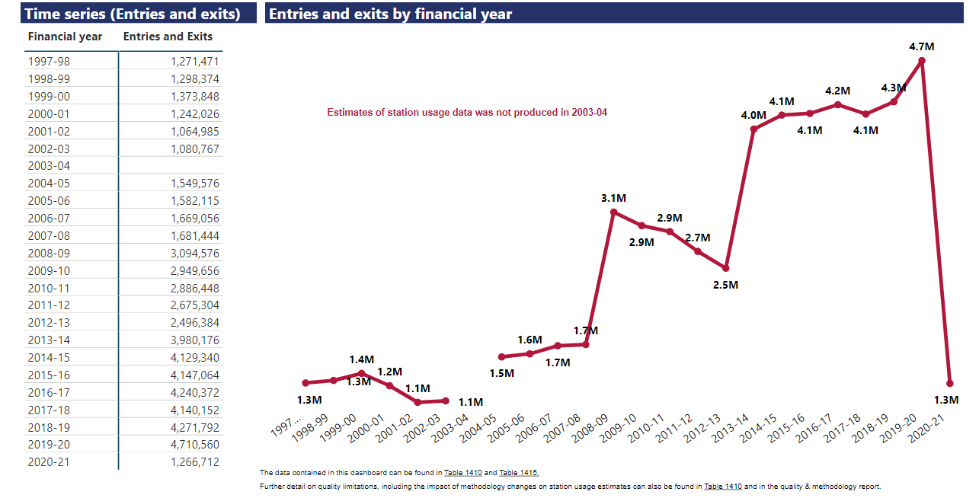
IS COVID A RESET MOMENT?
Southport station usage
How many people must have reconsidered their daily commuting lifestyle?

Slide 11
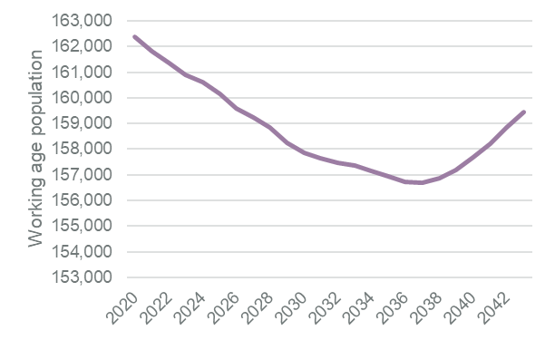
SEFTON NEEDS ITS RESIDENTS
The working age population is expected to shrink until at least 2038 – and after that the forecasts rely on residents not yet born
Projected population aged 16-64 time series 2020-2042

Slide 12
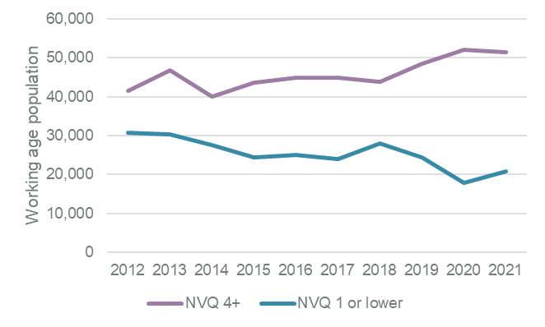
INCREASING SKILL LEVELS
Working age population skills achievement
Skills performance across the workforce is improving

Slide 13
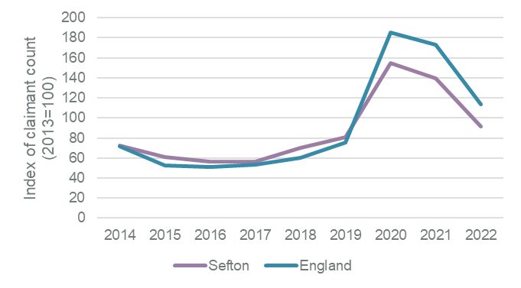
REBOUNDING AFTER COVID
Total out of work claimant count Sefton v England index (2012=100)
The impact of Covid – though a personal / business tragedy for many – has had a lower impact on the workforce in Sefton than in England

Slide 14
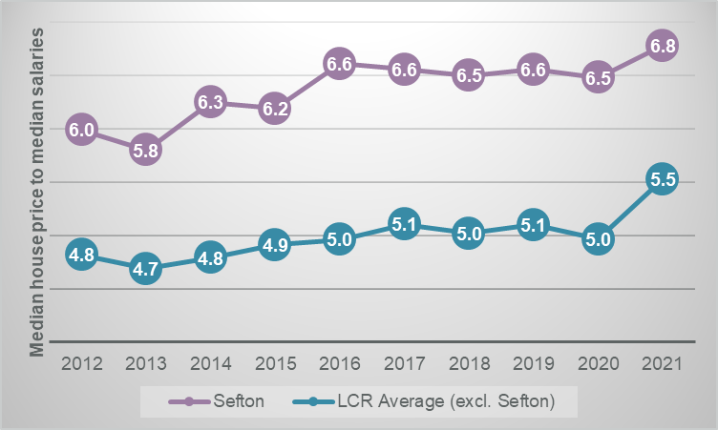
PEOPLE WANT TO LIVE HERE
Housing Affordability ratio – Sefton & LCR
Affordability ratios are a double edged sword – show a high demand for the area but represent a social problem for those trying to get on the housing ladder

Slide 15
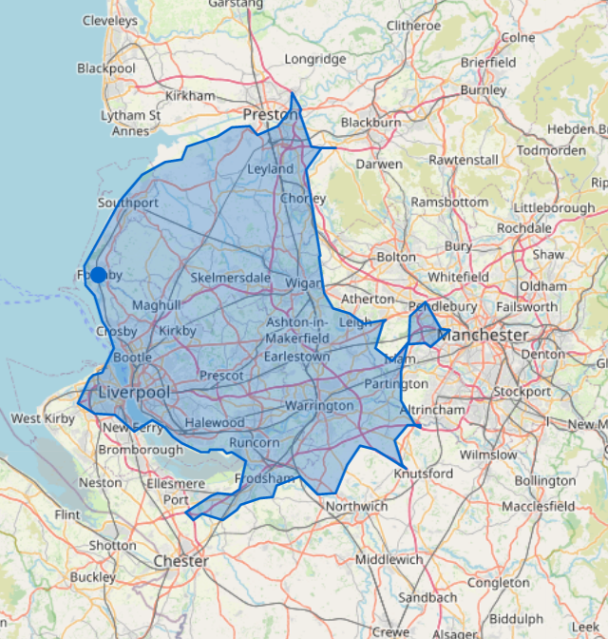
ACCESSIBLE QUALITY
Compare the 45 minute drive time from our location today with other coastal lifestyle opportunities

Slide 16
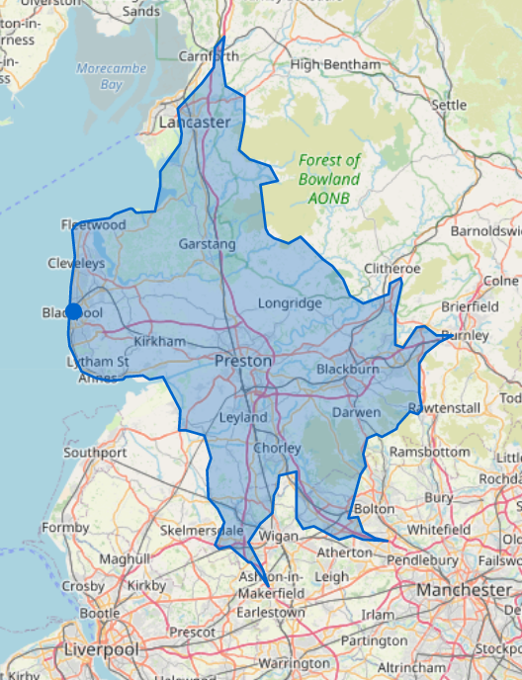
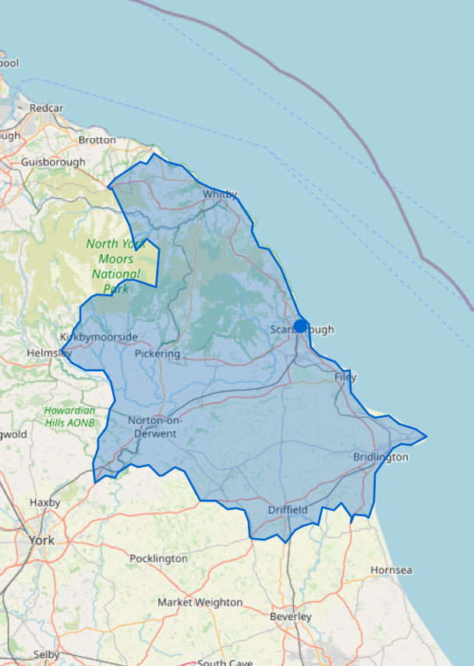
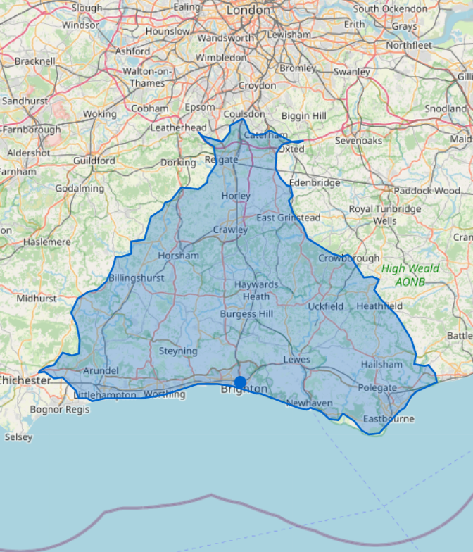
BEST OF BOTH WORLDS
Blackpool
Scarborough
Brighton

Slide 17
CONCLUSIONS
Not a comprehensive list but from today…
Reasons to be optimistic – things to build on | Areas of concern – need for action
Economic activity of residents | Hard to address & very severe deprivation
Covid workforce recovery | Falling working age population
Improving skills | High levels of public sector employment – and income effect
Reconsidering a post-Covid lifestyle | Poor levels of business density across the city region
Greater opportunity to work remotely
Improvements in place

Slide 18
BUILDING THE STRATEGY
Working headings for the strategy – though consultation may result in change…
Employment and opportunities for work
Business Growth & Investment
Social inclusion and access for all
Regenerated places

Slide 19
THANK YOU
Mickledore Ltd.
Nigel Wilcock
Director
nwilcock@regionaldevelopment.co.uk
01925 837679
07747 085400
Unit 207
The Base
Dallam Lane
Warrington
WA2 7NG

