Slide 1
14th July 2022
Sefton Economic Forum
North West Agency
Agent: Alison Stuart
Deputy Agent: Ken Clark
14th July 2022

Slide 2

Plan for the session
National economic outlook and monetary policy
Regional/local labour market picture
Intelligence from Bank’s regional contacts

Slide 3




Economic Outlook - Main points
Higher energy and goods prices have pushed inflation to 9.1%
We expect inflation to rise to around 11% this year, and the economy to slow
We’ve put up interest rates to help inflation return to our 2% target
Expect inflation to fall next year, as energy and tradables prices stabilise. Expect to be close to our 2% target in around two years
War in Ukraine led to further sharp rises in commodity prices and more pressure on global supply chains
Tight labour market and with businesses beginning to rebuild margins…upward pressure on wages and prices

Slide 4
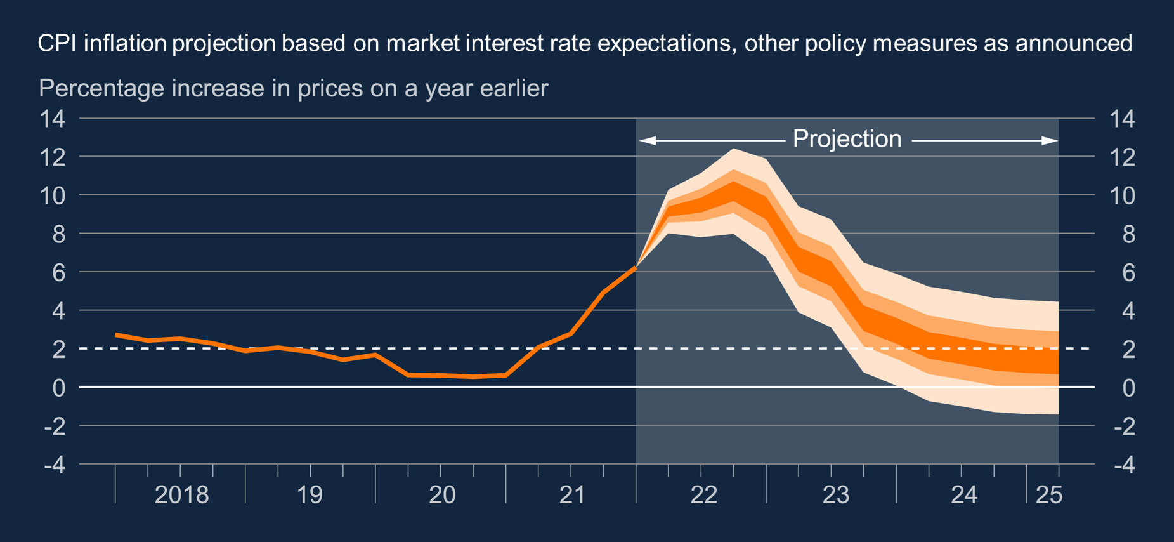
Inflation outlook (May forecast)

Slide 5
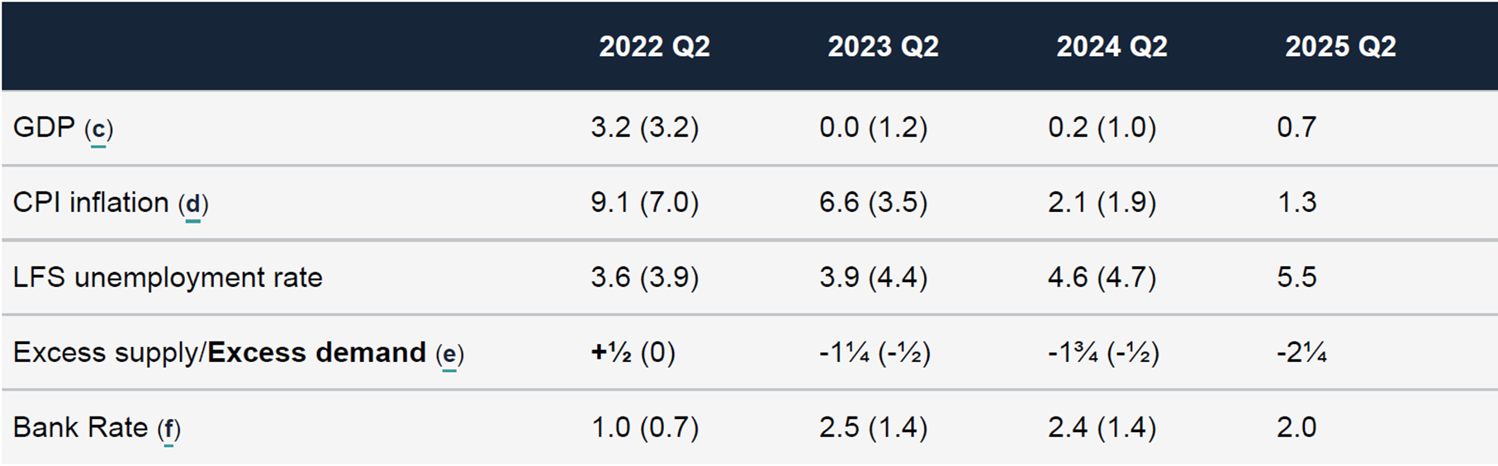
May forecast
GDP growth slows to below trend rates, with a fall in 2022Q4
Inflation peaks in Q4 and then falls back below target
Unemployment rises to 5.5%
(four-quarter growth, %)

Slide 6
Four key forecast judgements
Prices of commodities and other tradables stabilise
Beyond the near term, the labour market turns down
The squeeze on incomes leads to a slowing in demand
Domestic price pressure build, but fade again as spare capacity opens up

Slide 7
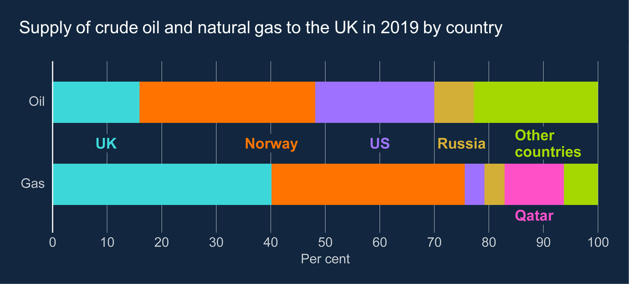
Russia is not a major source for UK energy
UK imports relatively little oil and very little gas directly from Russia
But prices UK pays set in global or European markets

Slide 8
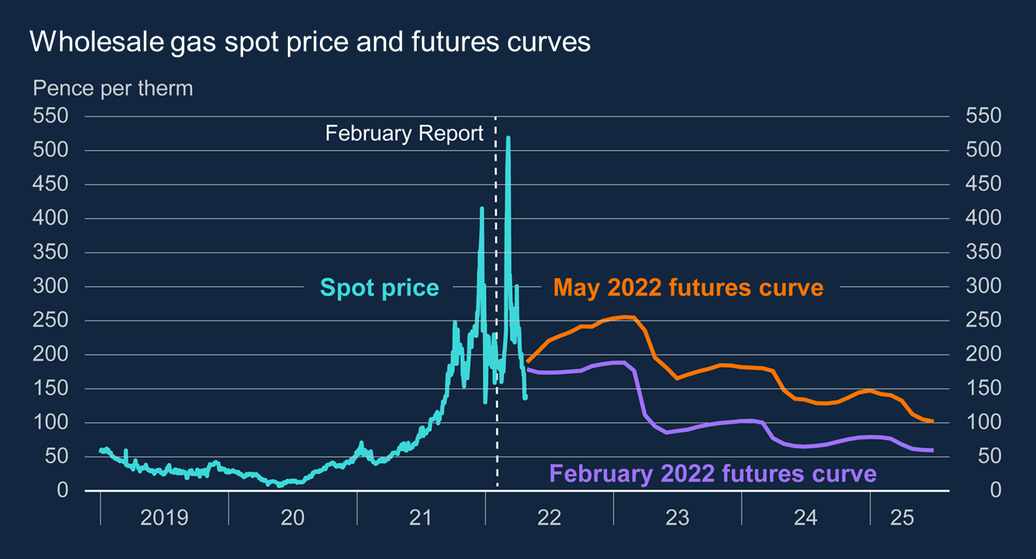
Gas futures curves are materially higher than in February
Gas prices hit historic highs in the aftermath of the invasion
Futures curve is well above February level
This is likely to push Ofgem’s energy price cap up by another 40% in October.

Slide 9
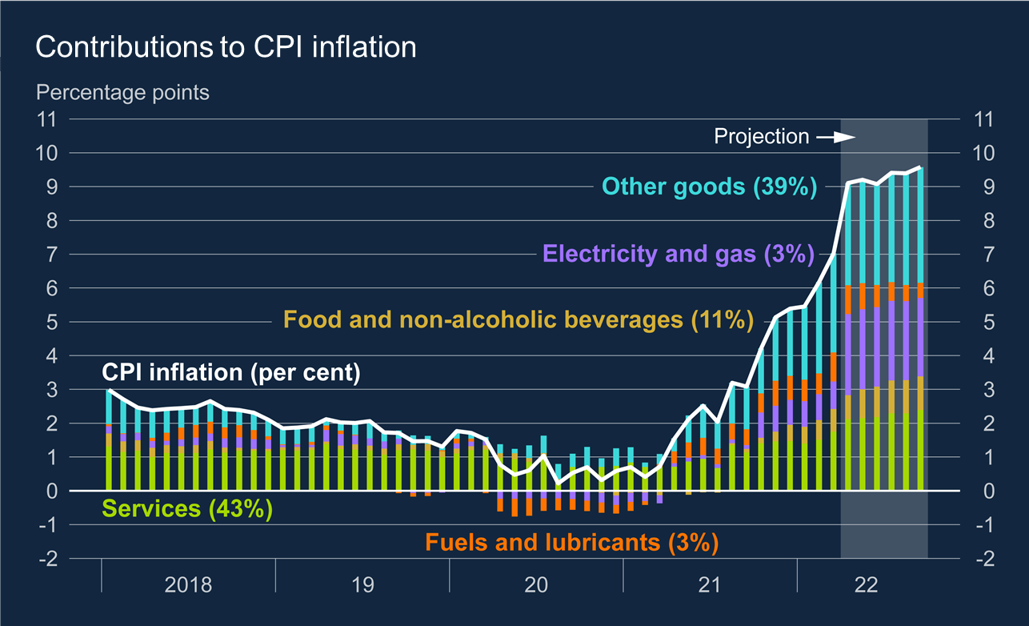
Energy and goods prices the major drivers behind the pick up in inflation
Energy and other goods prices
Services inflation also drifting higher
Will rise further when the Ofgem price cap is reset in October

Slide 10
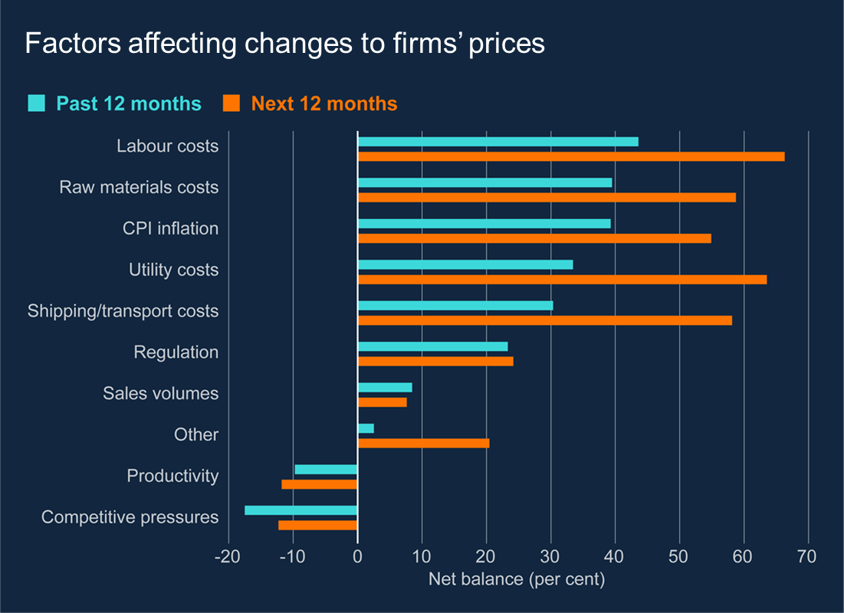
Business identify range of domestic and global factors pushing up prices
Respondents to Agents’ survey see the global influences on upward prices (raw materials, energy, shipping)…
…but also identify labour costs and higher overall inflation as an issue

Slide 11
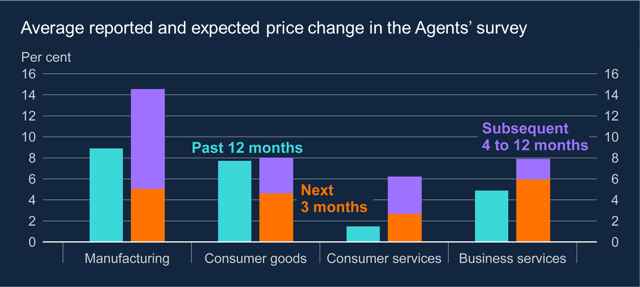
Business across all sectors plan to raise prices by more than last year
Businesses across all sectors plan to raise prices by more than last year, with a large chunk of that reported to be over the next three months

Slide 12
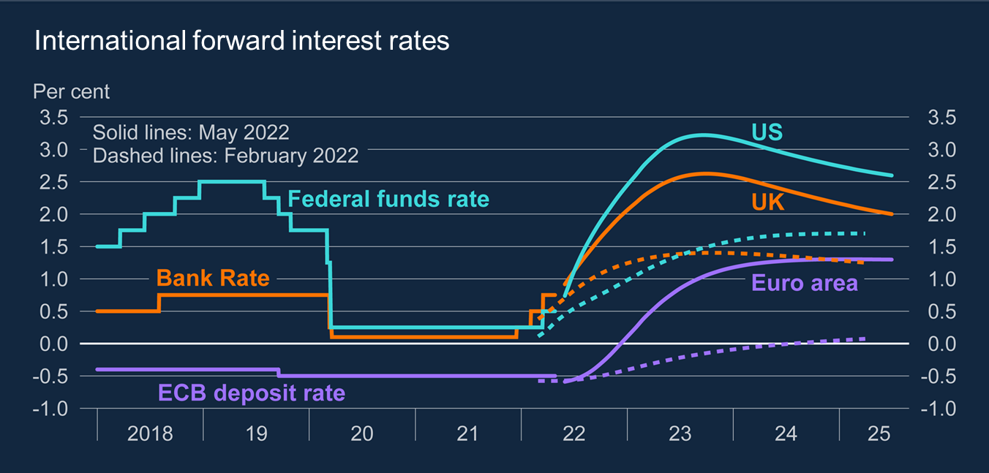
Policy-rate expectations have moved sharply higher globally
Rate expectations have increased in US, UK and EA since Feb
UK yield curve peaks at over 2.5%

Slide 13
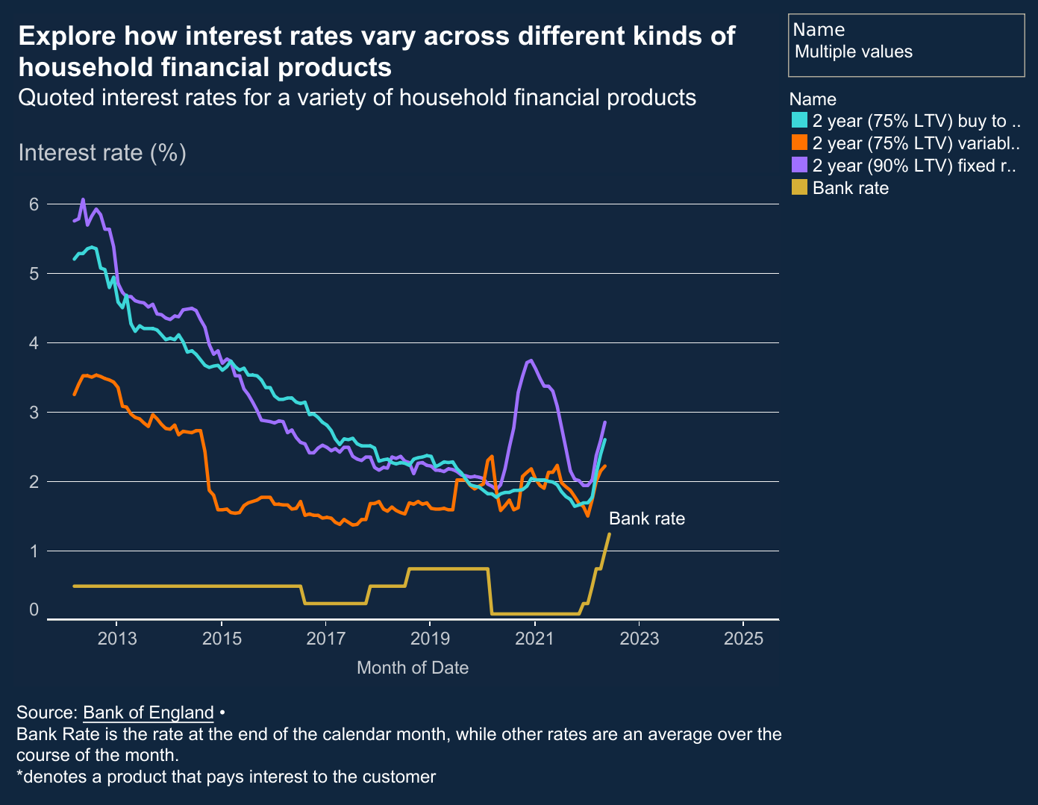
The MPC has been raising interest rates since December 2021
Rates previously at historically low levels (Bank Rate averaged 12% in the 1980s).
Market expectations are for rates to peak around 3.3% in 2023
Rate rises are being felt in mortgage markets
And also in some lending rates to businesses

Slide 14
Latest MPC policy decision (16th June 2022)
“In view of continuing robust cost and price pressures, including tightness of the labour market, and the risk those pressures became more persistent, all members of the Committee judged that an increase in Bank Rate was warranted at this meeting.” - MPC Minutes (June 2022, para 37)
MPC voted by 6-3 to raise Bank Rate by 25bp to 1.25%
5th straight increase from 0.1% last December & expected by the market.

Slide 15
Very challenging “Narrow Path” for monetary policy
Andrew Bailey – Monetary Policy seeking an uncertain “narrow path” between recession & sustained high inflation
6 members preferred 25bp – put more emphasis on downside risks for GDP and unemployment
3 members preferred a 50bp increase – put more emphasis on upside risks to inflation from strong labour market & risk of self-sustaining inflation (second-round effects)

Slide 16
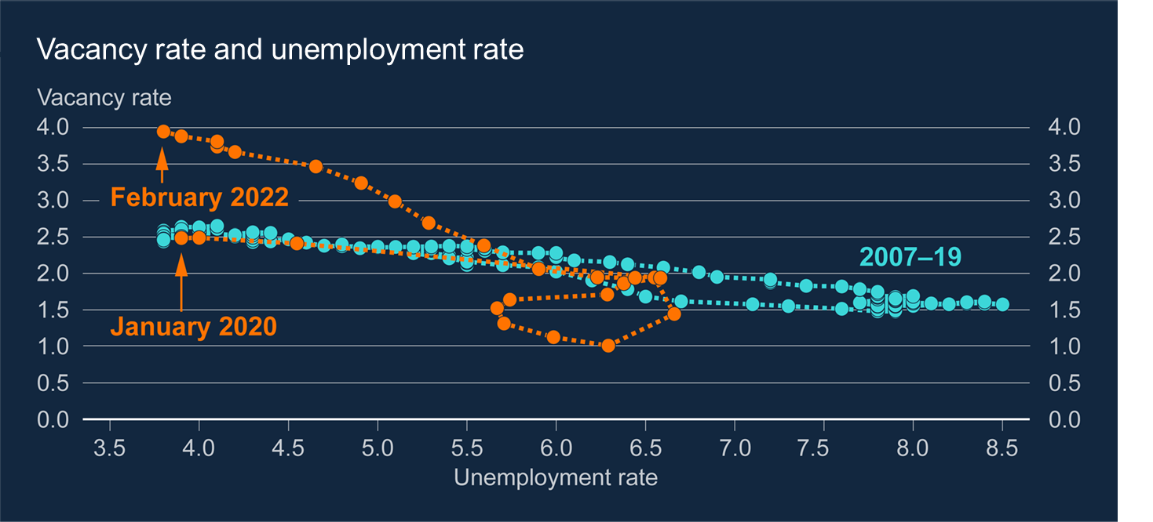
The labour market is very tight
Vacancies are much higher than they were the last time unemployment was at this level

Slide 17
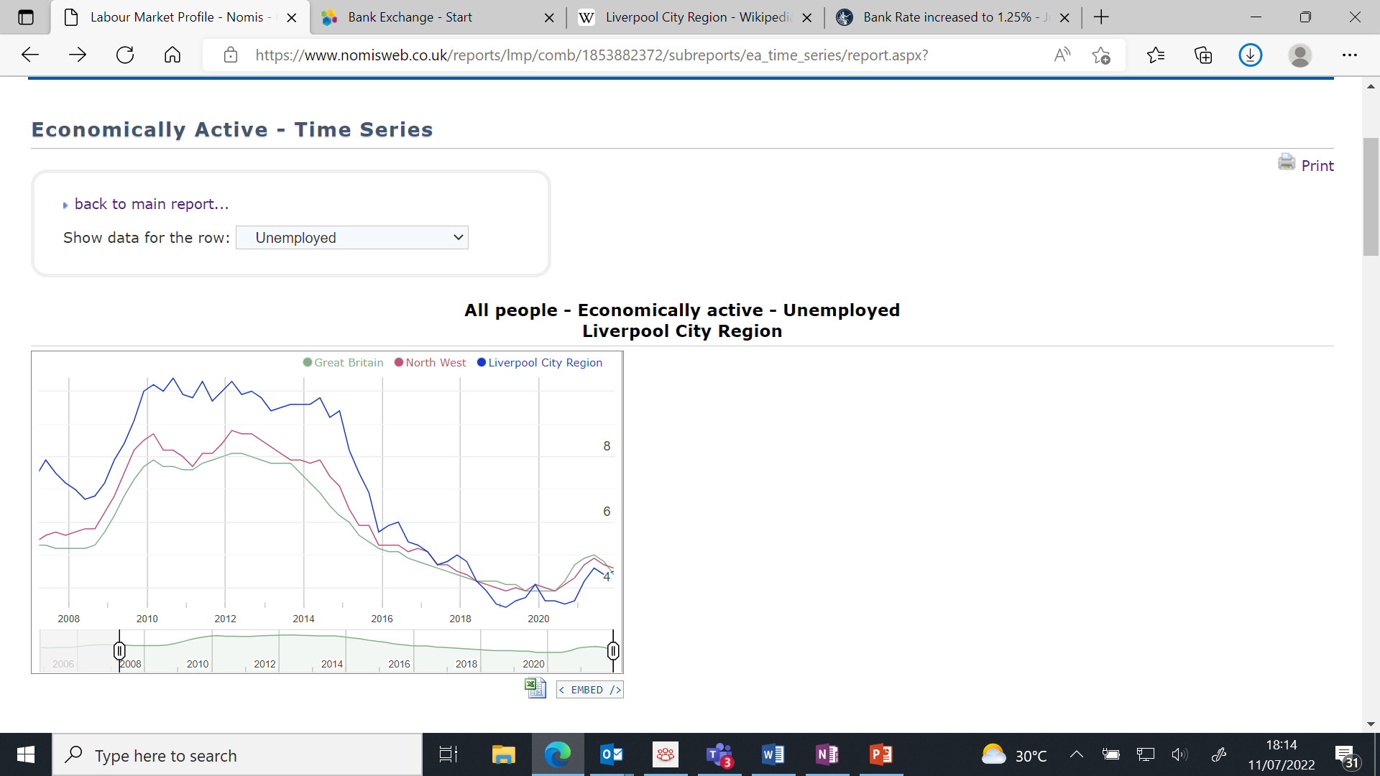

Slide 20
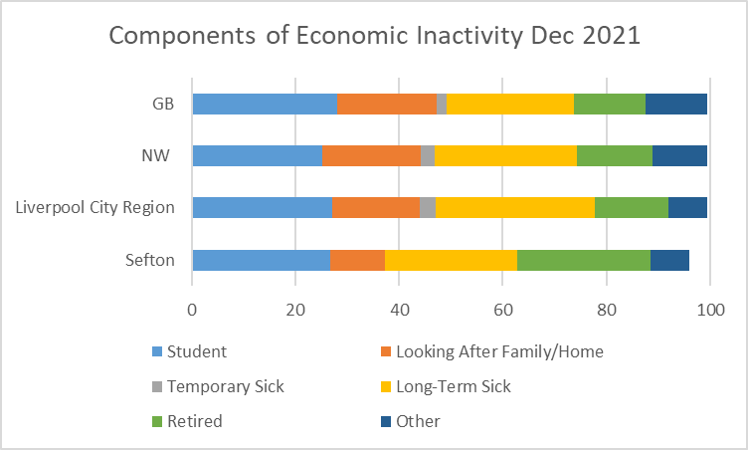

Slide 21
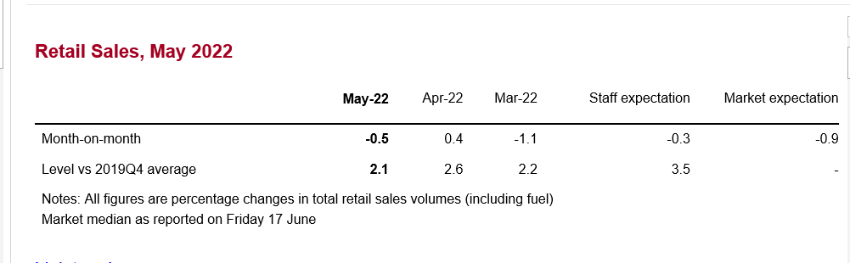
Agency Intelligence – Consumer spending
Growing signs of pressure on real incomes starting to weigh on demand for goods and consumer confidence
  Particularly in durable goods e.g. home improvement products
  Consumers trading down to lower priced alternatives or stores
  Hospitality and leisure stronger
Notes:
MPC tries to signal direction of travel in interest rates with a statement of “forward guidance”.
1ST BULLET means MPC will do whatever it takes to return CPI inflation back to 2% target.
2nd BULLET policy will evolve at each meeting in line with the evidence before them – the data & news since the last decision.
3rd BULLET in red, signals the Cttee is prepared to act more aggressively – i.e. to increase rates by more than 25bp at a time.
Think that more aggressive/larger increases will dep on how long the labour market remains tight – bcos the lab mkt is the prime determinant of domestically-generated inflation.

Slide 22
Agency Intelligence – Business Services
Strong growth in turnover, supported by higher volumes and fees, but growth was constrained by labour shortages.
By contrast, merger and acquisition activity appeared to be slowing from its previously high rates.
And some reported a pickup in insolvency work.
Notes:
MPC tries to signal direction of travel in interest rates with a statement of “forward guidance”.
1ST BULLET means MPC will do whatever it takes to return CPI inflation back to 2% target.
2nd BULLET policy will evolve at each meeting in line with the evidence before them – the data & news since the last decision.
3rd BULLET in red, signals the Cttee is prepared to act more aggressively – i.e. to increase rates by more than 25bp at a time.
Think that more aggressive/larger increases will dep on how long the labour market remains tight – bcos the lab mkt is the prime determinant of domestically-generated inflation.

Slide 23
Agency Intelligence – Supply Chains
Manufacturing output growth weakening as shortages of materials and components constrain output.
Shortages had worsened since Russia's invasion of Ukraine and following Covid-related lockdowns in China.
Shortages of: sunflower oil, organic grain, timber, paper, bricks, steel, IT equipment, titanium, palladium, electric motors, microchips, wiring harnesses, mechanical parts, electronic components and roof tiles.
Companies adapting in various ways e.g. re/near-shoring or holding more stock.
Disruption expected to persist into next year, possibly longer.
Notes:
MPC tries to signal direction of travel in interest rates with a statement of “forward guidance”.
1ST BULLET means MPC will do whatever it takes to return CPI inflation back to 2% target.
2nd BULLET policy will evolve at each meeting in line with the evidence before them – the data & news since the last decision.
3rd BULLET in red, signals the Cttee is prepared to act more aggressively – i.e. to increase rates by more than 25bp at a time.
Think that more aggressive/larger increases will dep on how long the labour market remains tight – bcos the lab mkt is the prime determinant of domestically-generated inflation.

Slide 24
Agency Intelligence – Employment and Pay
Companies employment intentions remain strong
  Driven by expected demand growth
  Replacing leavers
Recruitment difficulties are acute and broad-based
  Poaching and bidding “war for talent” in professional services
  Unfilled vacancies in many sectors
Pay inflation picking up sharply
  NLW increase of 6.6% in April
  Average of around 6% across economy
Notes:
MPC tries to signal direction of travel in interest rates with a statement of “forward guidance”.
1ST BULLET means MPC will do whatever it takes to return CPI inflation back to 2% target.
2nd BULLET policy will evolve at each meeting in line with the evidence before them – the data & news since the last decision.
3rd BULLET in red, signals the Cttee is prepared to act more aggressively – i.e. to increase rates by more than 25bp at a time.
Think that more aggressive/larger increases will dep on how long the labour market remains tight – bcos the lab mkt is the prime determinant of domestically-generated inflation.

Slide 25
“Forward Guidance” – where next for policy?
“The MPC would take the actions necessary to return inflation to the 2% target sustainably in the medium term, in line with its remit.”
“The scale, pace and timing of any further increases in Bank Rate would reflect the Committee’s assessment of the economic outlook and inflationary pressures.”
“The Committee would be particularly alert to indications of more persistent inflationary pressures, and would if necessary act forcefully in response.” - MPC minutes (June 2022, para 40)
Notes:
MPC tries to signal direction of travel in interest rates with a statement of “forward guidance”.
1ST BULLET means MPC will do whatever it takes to return CPI inflation back to 2% target.
2nd BULLET policy will evolve at each meeting in line with the evidence before them – the data & news since the last decision.
3rd BULLET in red, signals the Cttee is prepared to act more aggressively – i.e. to increase rates by more than 25bp at a time.
Think that more aggressive/larger increases will dep on how long the labour market remains tight – bcos the lab mkt is the prime determinant of domestically-generated inflation.

Slide 26
Ken.Clark@bankofengland.co.uk
Email: Northwest@bankofengland.co.uk
Twitter: @BoENorthWest

