Slide 1

Liverpool European Partnership Business
Introduction
Sefton Economic Forum
Wednesday, 24 June, 9-11am (Formby Hall)

Slide 2
Update from the Liverpool
European Partnership team
Gosia McKane
Director, Liverpool European Partnership
Peter Schriewersmann
Business Lead, Liverpool European Partnership
Co-Owner of Happy Days Apartments, Hotel Anfield & Onyx Real Estate
Bulgarian Honorary Consul for Liverpool Region

Slide 3

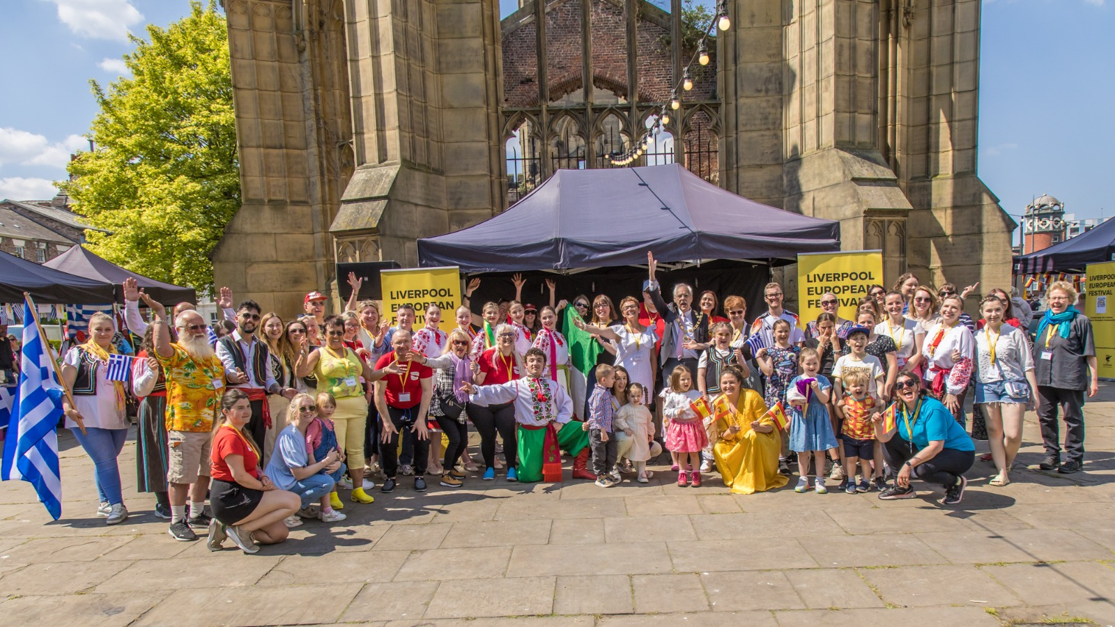
Update from the Liverpool
European Partnership team

Slide 4
Liverpool european partnership
wider context
Forward momentum in the UK-European relationship:
New frameworks, practical projects and the will to work together.
July Summit (Second Edition)
Forward momentum in the Liverpool City Region European outlook:
Liverpool European Partnership Business Network connecting European businesses and professionals with the city region and with each other.

Slide 5
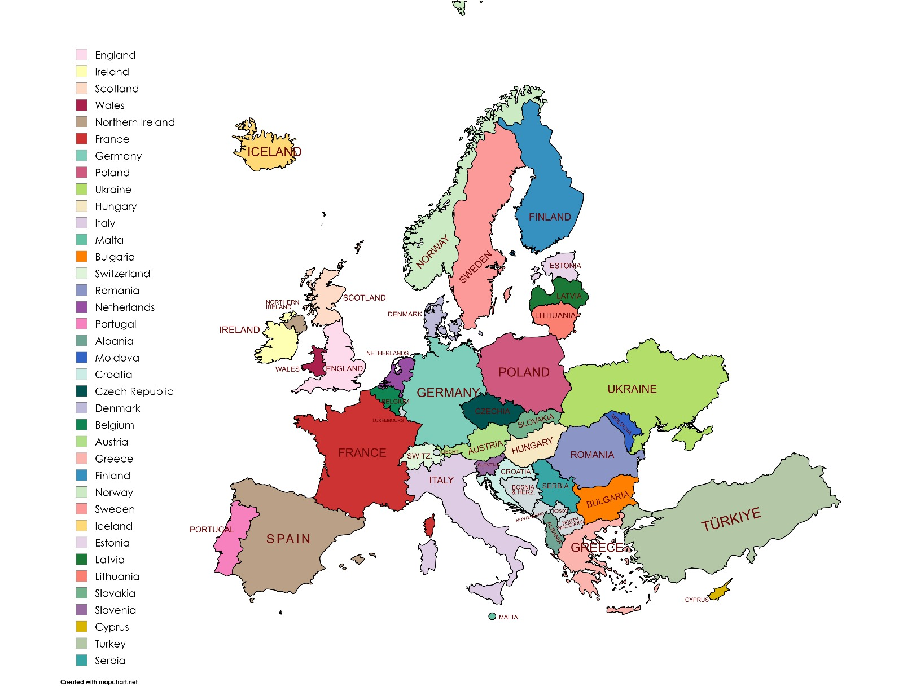
CONNECTIONS MAP
NETWORKING OPPORTUNITIES

Slide 6
LIVERPOOL EUROPEAN PARTNERSHIP
CONTACTS
Email: business@liverpooleuropeanpartnership.co.uk
LinkedIn: liverpooleuropeanpartnership
THANKS FOR LISTENING!
LET’S NETWORK…..

